Slide 1


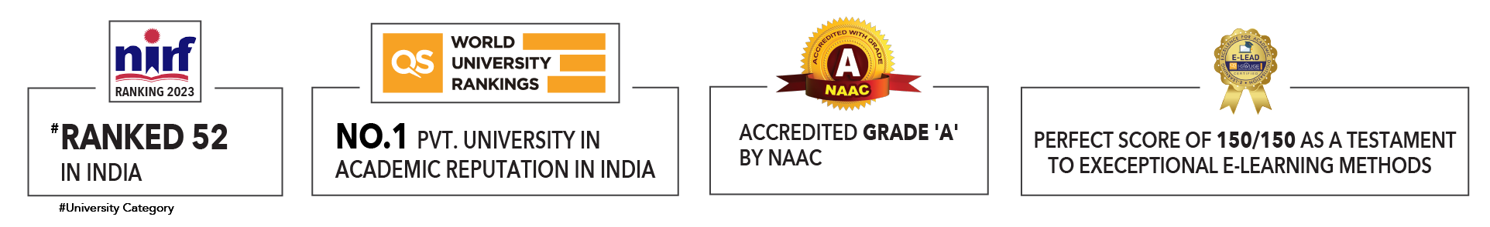

Slide 2

Unit 1 : Introduction to Operating System
Lecture 3
Dr. Hemant Petwal
School of Computer Science UPES, Dehradun
India

Slide 3
Table of Contents
Service of Operating System
Computing Environments

Slide 4
Learning & Course Outcomes
Learning Outcomes
LO1: Understand the services of Operating System
LO2: Understand different computing environments
Course Outcomes
CO1: Demonstrate a comprehensive understanding of operating systems

Slide 5
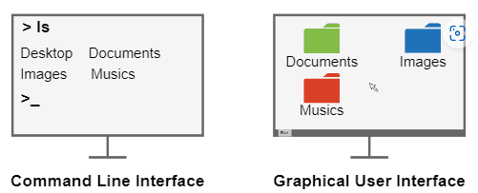
Services of Operating System
Operating systems (OS) offer a wide range of services to facilitate efficient and secure computing for users and applications.
User Interface Service
The user interface is the service that practically enables users to interact with an operating system. So, it means interacting with the entire computer system itself.
The user interface of operating systems has two common forms: the Command Line Interface (CLI) and the Graphical User Interface (GUI).
Fig 1. User Interface service in OS

Slide 6
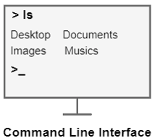
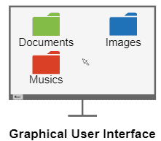
Services of Operating System
A CLI establishes the interaction between users and the operating system through a text-based set of commands. Thus, the users type commands and their respective arguments and submit them to be processed by the operating system.
Examples of CLI interfaces are the command prompt of Windows and the terminal of Linux-based systems.
GUI, consists of a windowed graphical design with which the users can interact by clicking with the mouse and typing with the keyboard.
Graphical interfaces are considered more user-friendly than the commando line ones. So, they are widely adopted in general-purpose operating systems.
Examples of GUI designs are the Microsoft Metro and the Linux GNOME.

Slide 7
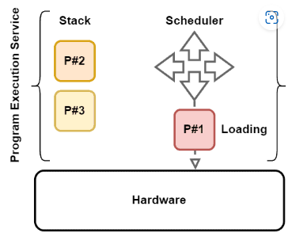
Services of Operating System
Program Execution Service
Another vital service of the operating system is program execution.
To execute a program, operating systems tackle several operations, such as program loading, management of execution stacks, and process scheduling.
The following image sketches the program execution service of operating systems
This service allows different users to use the same operating system to deal with distinct tasks through running heterogeneous programs.
Fig 2. Program execution service in OS

Slide 8
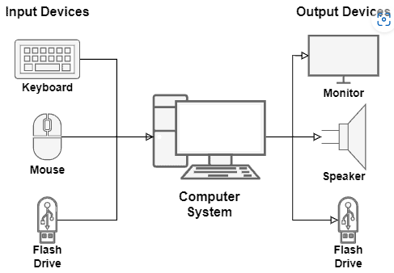
Services of Operating System
Input/Output Operations Service
A user can not directly control Input/Output (I/O) devices, such as monitors, speakers, keyboards, and mouses.
So, operating systems mediate the communication between the user, I/O devices, and the computer system.
The operating system provides a I/O service with several system calls and interrupts that can both send and receive operation requests to the available I/O devices.
It is important that controlling the I/O operations of a specific device may require the installation of drivers. Drivers, in turn, supply a kind of guideline to the operating system on how to communicate with particular I/O devices.
Fig 3. I/O Operation service in OS

Slide 9
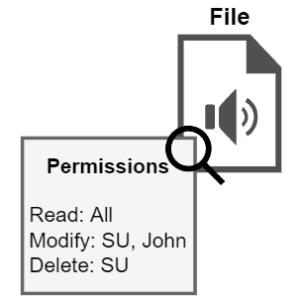
Services of Operating System
File System Management Service
The file system keeps and organizes all the files of a computer in persistent memory, usually a Hard Disk (HD) or Solid-State Drive (SSD).
However, it is normal for the user to create, modify, delete, and search data files, Directory in the file system. Thus, the operating system provides a service for the users to manipulate the file system, enabling them to execute the cited management operations.
Furthermore, the operation systems control the permissions given to users and programs to access files. These permissions (or restrictions) are applied to avoid unauthorized modifications and reads of crucial files, which can damage the computer system.
Fig 4. Permission on a File in OS

Slide 10
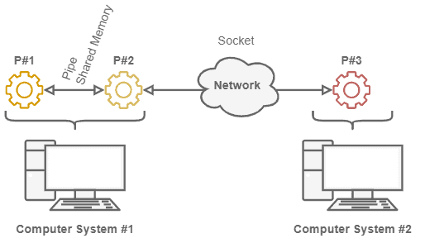
Services of Operating System
Communications Service
In OS, communication represents the data exchange between processes.
These processes, in turn, may execute on the same computer or different computers. So, in different computers case, different computers communicate with each other through a network.
The operating system has specific mechanisms to enable processes running in the same computer to communicate. The most common examples are pipes and shared memory.
Fig 5. Communication between Different systems

Slide 11
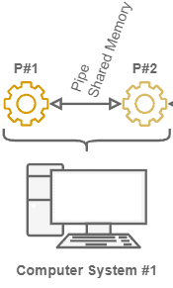
Services of Operating System
Pipes
It consist of data buffers that connect two processes. In technical terms, the operating system associates file descriptors to each pipe: one for reading and another for writing it.
Shared Memory Regions
The other option is using memory regions shared between two or more processes. In this case, the operating system defines the shared memory regions. The addresses of these regions are included in the addressing spaces of the processes, which can exchange data through them.
Fig 6. Pipe/ Shared Memory between Processes

Slide 12
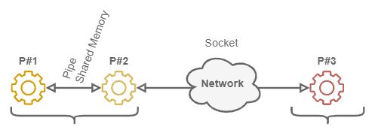
Services of Operating System
Sockets
If we consider processes communicating over the network, most operating systems provide the mechanism of sockets.
Sockets are descriptors associated with a file representing a network connection. So, the processes can indicate the data to be sent and its destination through a socket. The operating system, in turn, triggers the requested message sent through the network.
System 1
System 2
Fig 7. Communication through Socket between processes of Different Systems

Slide 13
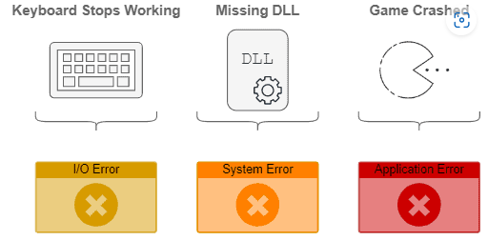
Services of Operating System
Error Detection Service
During a computer system lifecycle, several errors can occur. For example, we can have CPU errors, memory bad allocations or accesses, a component failure causing a hardware error, or even an error caused by an I/O device.
The error detection service of operating systems must avoid a computer system completely breaking down when an error happens.
So, this service must catch errors and manage them, keeping the entire system as functional as possible.
Furthermore, the error detection service must be able to inform the user about the errors, showing their codes, descriptions, and, if known, manners to fix them.
The image next presents error situations that may occur and be handled by the operating system
Fig 8. Error and detection in OS

Slide 14
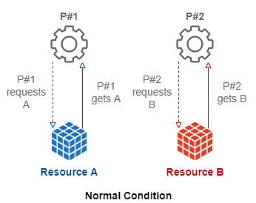
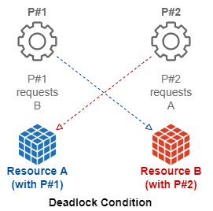
Services of Operating System
Resource Allocation Service
Resource allocation means dedicating computing resources to processes and users. We have many resource types, such as CPU (actually, CPU time), memory, networking, and I/O devices. So, as the operating system controls these resources, it naturally decides which processes use them.
During the lifecycle, a process will typically require multiple computing resources.
There are two main resource management challenges:
A process demanding a particular resource never gets it;
A process with a resource never releases it.
Fig 9. Resource Allocation service in OS

Slide 15
Services of Operating System
Resource Allocation Service
In normal condition, processes request or their required resources and get it. Once computation is completed, they release the resources. Thus, resource becomes available for next process.
Two processes hold particular resources required by both. So, they indefinitely wait for each other to release these resources. We call this condition a deadlock.

Slide 16
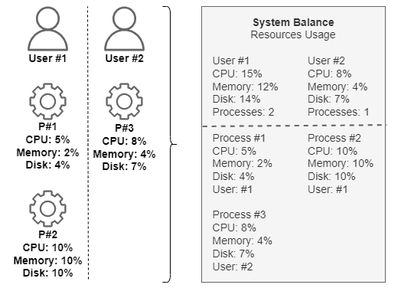
Services of Operating System
Accounting Service
Accounting consists of keeping track of the behavior of both users and processes in the computing system.
For instance, the operating system analyzes which users require the execution of which processes. So, it can also investigate how many computing resources are requested by the processes executing on the computer.
Finally, the operating system can correlate the obtained information and generate statistics about the users of the computer system and the processes running on it.
Fig 10. Accounting service in OS

Slide 17
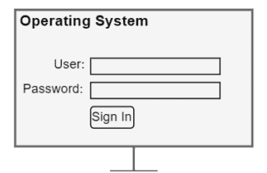
Services of Operating System
Security Service
Regarding the operating system, we can understand security in different aspects.
The first aspect consists of internal security for the processes. The operating system must be able to guarantee the correct execution of processes.
Another relevant aspect of security is guaranteeing that only authorized users trigger the creation, modification, and remotion of resources and processes in the computer system.
So, the operating system must provide authentication methods to the users to prove they are who they claim to be. The most usual authentication method employed by operating systems is single-factor password-based authentication.
Fig 11. Security service in OS

Slide 18
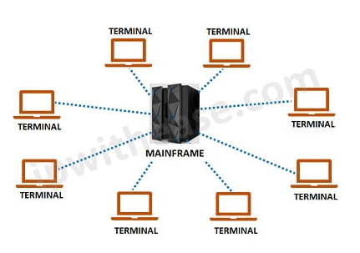
Operating System: Computing Environments
Mainframe Computing Environment: A large and powerful computer system used for critical applications and large-scale data processing.
Example: IBM Z Series mainframes used by large financial institutions
Components (Hardware)
Mainframe Computer: Centralized, high-performance computers designed for large-scale processing.
Storage Systems: High-capacity storage units (e.g., disk arrays, tape drives).
Input/Output Devices: High-speed printers, terminals.
Networking Components: High-bandwidth network interfaces to connect with various systems and devices.
Fig 12. Mainframe computing

Slide 19
Operating System: Computing Environments
Mainframe Computing Environment : A large and powerful computer system used for critical applications and large-scale data processing.
Components (Software)
Operating System: Specialized mainframe OS such as z/OS, z/VM, or Linux on Z.
Middleware: Software to manage communication and data exchange between applications (e.g., CICS for transaction processing, DB2 for database management).
Applications: Business-critical applications for finance, insurance, retail, and other industries.
Utility Areas: Enterprise Resource Planning (ERP), Data Analysis and Reporting, ATM and Online Banking, Historical Data Storage
Fig 12. Mainframe computing

Slide 20
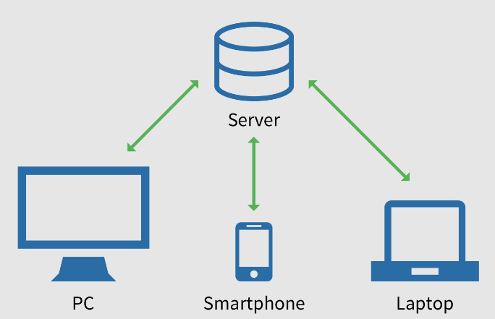
Operating System: Computing Environments
Client-Server Computing Environment : A computing environment in which client devices access resources and services from a central server.
Example: A company’s internal email system
Components
Hardware: Servers (email servers, database servers), client machines (desktops, laptops)
Software: Server OS (Windows Server, Linux), client applications (Outlook, web browsers)
Utility Areas
Enterprise Applications: Email services, database management, internal websites.
Resource Sharing: Centralized storage, shared printers and devices.
Fig 13. Client-Server Computing
Security and Management: Centralized authentication, access controls, and monitoring.

Slide 21
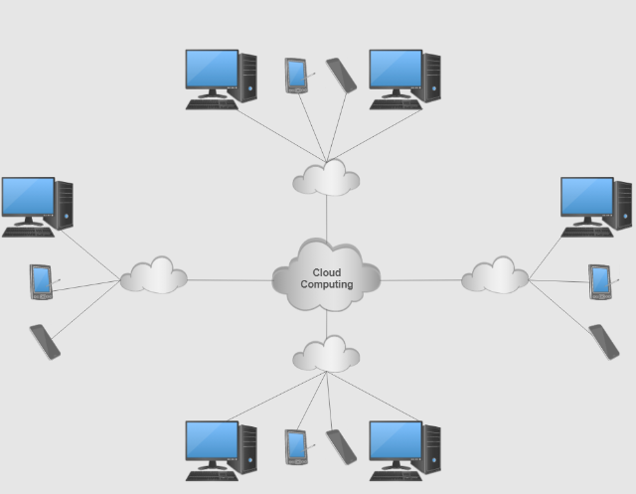
Operating System: Computing Environments
Cloud Computing Environment : A computing environment in which resources and services are provided over the Internet and accessed through a web browser or client software.
Example: Google Cloud Platform (GCP), Amazon Web Services
(AWS), Microsoft Azure
Components
Hardware: Data centers with thousands of servers
Software: Virtualization software, cloud management platforms, APIs.
Utility Areas
Scalability: Dynamic allocation of resources for web applications, databases.
Cost Efficiency: Pay-as-you-go model for resources.
Disaster Recovery: Backup and restore capabilities across multiple data centers
Fig 14. Cloud Computing Environment

Slide 22
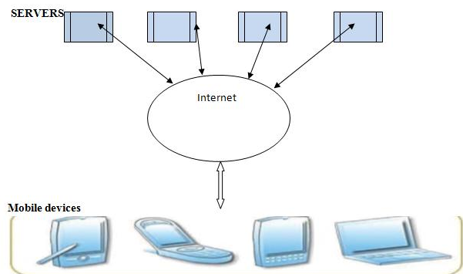
Operating System: Computing Environments
Mobile Computing Environment : A computing environment in which users access information and applications using handheld devices such as smartphones and tablets.
Example: Smartphones, Tablets
Components
Hardware: Mobile processors, touchscreens, sensors (GPS, accelerometer).
Software: Mobile OS (iOS, Android), mobile applications (apps)
Utility Areas
Communication: Messaging, video calls.
Navigation: GPS, maps.
Entertainment: Games, media consumption
Fig 15. Mobile Computing Environment

Slide 23
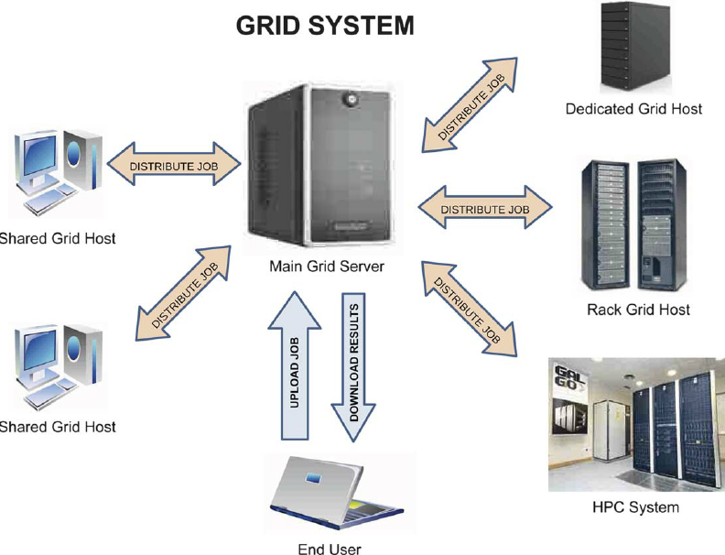
Operating System: Computing Environments
Grid Computing Environment : A computing environment in which resources and services are shared across multiple computers to perform large-scale computations.
Example: The Large Hadron Collider (LHC) computing grid used
by CERN for particle physics research.
Components
Hardware: Multiple interconnected computers, Distributed storage infrastructure, High-speed networks and interconnects
Software: OS (Linux), Application Software (task specific), security tools
Utility Areas
Scientific Research: Physics, Biology.
Data-Intensive Applications: Climate Modeling, earthquack simulation
Healthcare: Medical Research, Personalized medicine
Fig 16. Grid Computing Environment

Slide 24
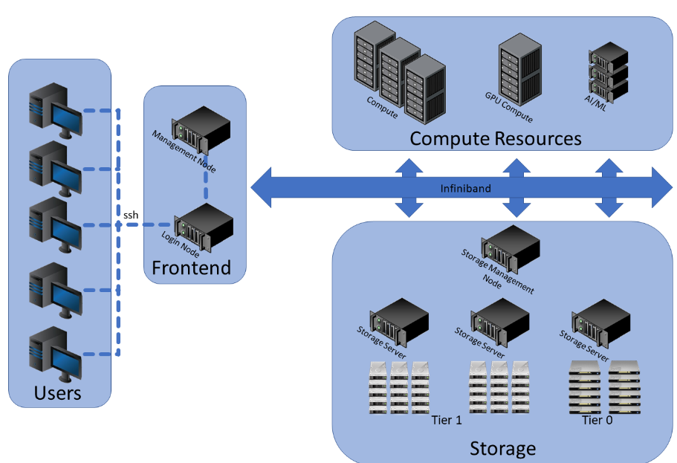
Operating System: Computing Environments
High-Performance Computing (HPC) Environment: A computing environment in which resources and services are shared across multiple computers to perform large-scale computations.
Example: Supercomputers like Summit, used by the Oak
Ridge National Laboratory
Components
Hardware: Thousands of CPUs/GPUs, high-speed interconnects.
Software: Specialized OS (Linux variants), parallel computing frameworks (MPI, CUDA)
Utility Areas
Scientific Simulations: Climate modeling, astrophysics
Complex Calculations: Cryptography, genomic research.
Data Analysis: Real-time data processing, financial modeling.
Fig 17. High Performance Computing Environment

Slide 25
MCQ
Q1. What is the primary role of the user interface in an operating system?
A. Managing memory B. Facilitating user interaction with the OS
C. Executing programs D. Managing hardware resources
Q2. What does the program execution service of an operating system handle?
A. Managing files B. Loading and scheduling programs
C. Network communication D. User authentication
Q3. What does the file system management service organize in a computer?
A. Memory allocation B. I/O devices
C. Network configurations D. Data files and directories
Q4. In OS terms, what does communication typically refer to?
A. User login and authentication B. Data exchange between processes
C. File transfer between computers D. Sending emails

Slide 26
MCQ
Q5. How do processes on different computers communicate in a networked environment?
A. Through shared memory B. Using pipes
C. Via network protocols D. Direct hardware access
Q6. What type of errors can the error detection service handle?
A. CPU errors B. Memory errors
C. I/O device errors D. All of the above
Q7. What does resource allocation in an OS typically involve?
Distributing resources like CPU B. Installing software updates
time and memory to processes
C. Managing network connections D. Executing user commands
Q8. Which method is commonly used for user authentication in operating systems?
A. Multi-factor authentication B. Password-based authentication
C. Biometric scanning D. Hardware tokens

Slide 27
MCQ
Question No-Answer | Option | Description
Q1- Answer | B | Facilitating user interaction with the OS
Q2- Answer | B | Loading and scheduling programs
Q3- Answer | D | Data files and directories
Q4- Answer | B | Data exchange between processes
Q5- Answer | C | Via network protocols
Q6- Answer | D | All of the above
Q7- Answer | A | Distributing resources like CPU time and memory to processes
Q8- Answer | B | Password-based authentication

Slide 28
Summary/Key Points
Operating systems (OS) offer a wide range of services to facilitate efficient and secure computing for users and applications.
User Interface Service
Program Execution Service
Input/Output Operations Service
File System Management Service
Communications Service
Error Detection Service
Resource Allocation Service
Accounting Service
Security Service
OS offers following computing environment i.e., Mainframe, Client-Server, Cloud Computing, Mobile Computing, Grid Computing, High Performance Computing.

Slide 29
Reference Material
Operating Systems Concepts (10th Ed.) Silberschatz A, Peterson J and Galvin P, John Wiley & Sons, Inc. 2018.
Topics:
Service of Operating System, Page No: 27-39, 55- 58
Computing Environments, Page No: 40-46
Modern Operating Systems (4th Ed.) by Andrew S. Tanenbaum and Herbert Bos, 2007
Operating Systems: Principles and Practice by Thomas Anderson and Michael Dahlin, 2014

Slide 30
Coming Up-Next Lecture
Virtualization and Containerization
Operating System Structures

Slide 31

Thank You

